Slide 1
DPL Software Design
Reference Implementation

Slide 2
How we design software
Formal software design role/process
Fed by story development
Adherence to common design principles
Information hiding
Designing for change
Separation of concerns
Maximize functional cohesiveness
Minimize coupling
Favor closed vs open architecture
Emphasis on minimizing complexity
Cleverness == complexity
Minimize your required “field of view”
Design for testability
Leverage tools and techniques from test-driven development
Consistent design methodology
More readable/maintainable code
Notes:
This is probably the area where we have made the most significant changes from what we had been doing prior to forming NG
Definitely the most impactful change we have made when it comes to
our ability to manage the complexity of the software we are building
and the funability factor

Slide 3
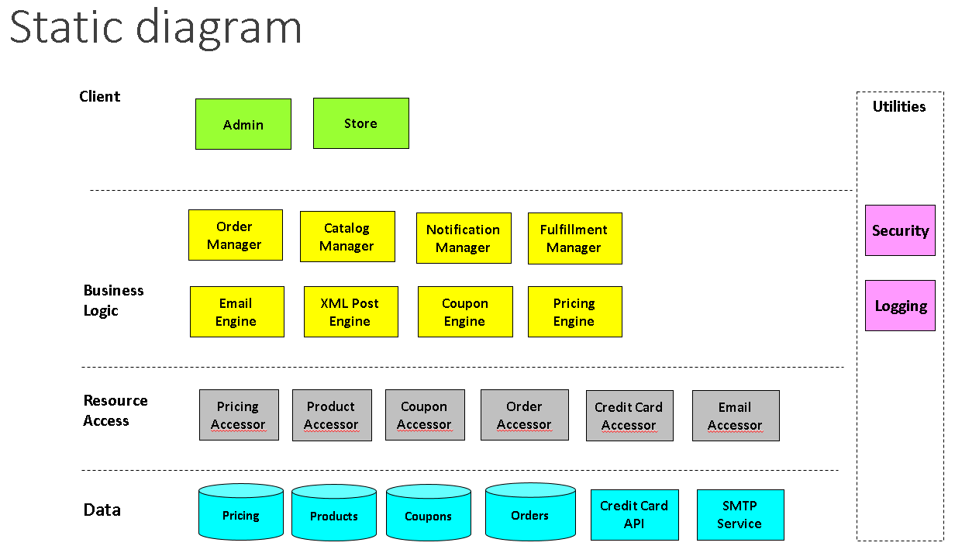
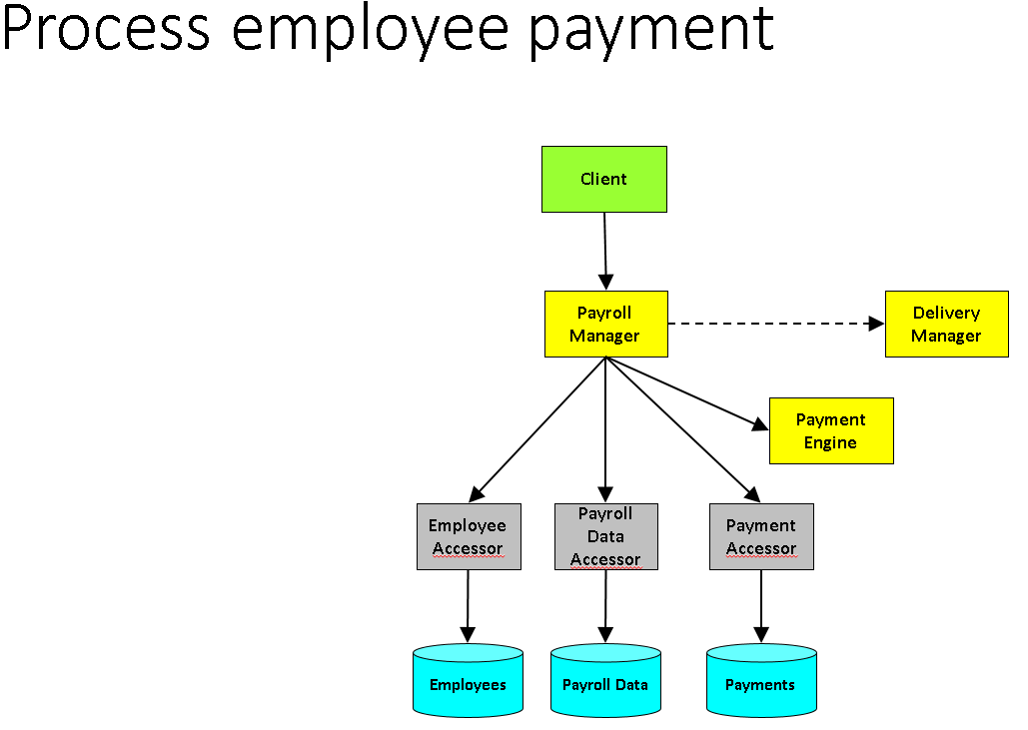
Consistent software design methodology
IDesign “Method”
Juval Lowy
http://www.idesign.net
Search “Zen of Architecture”
Simplified conventions and rules
Encapsulation of volatility / design for change
Information hiding
Every class is a “service”
Service orientation vs object-orientation
Multiple views of the design
Notes:
Volatility-based decomposition as opposed to O-O or Functional
Designing to interfaces/contracts
3-4 abstract roles that classes can have
Stateless business logic classes
Data contracts
Do you have a 1 or 2 sentence explanation for how IDesign is different than n-tier? I suspect many in the room have done n-tier and would hate for them to look at this and think it’s simply a diferent name for n-tier.
Slide 17: You might spend a little time speaking to how this helps both onboard developers and allos us to respond to change (I suspect you already are)

Slide 4
Review of our design conventions
Basic abstractions
Managers: Manages sequence of actions
Engines: Applies algorithm/business rule
Accessors: Data/resources
Utilities
Client
Layers (typical)
Clients
Business
Resource Access
Resources
Communication rules
Closed architecture
Services can only call down
Utility exception
Not allowed:
Manager -> Manager (sync)
Client -> Engine
Client -> Accessor
Manager / Engine
Accessor
Resource
Utility

Slide 5
Other considerations
Iceberg principle
Maximize the amount of business logic below the client tier
Design for testability
Require unit test development along with the business logic
Focus on service consumption

Slide 6
Impacts of unit testing on design quality
Forces consumption awareness in your code because you create the first consumer
Gets you focused on the interface rather than the implementation
Tends to create interfaces that are conveniently callable
Forces the software to be more testable which usually requires more decoupling from its surroundings
Things that are difficult to test tend to be simplified in order to achieve testability
Tests allow you to play “what if” games with broad changes to assess the impact to the design
Makes the code more understandable/readable
Unit tests that describe how the developer intended the code to be consumed
Built in example code!

Slide 7
Buyer User Stories
Browse a catalog of products
Adding items to a shopping cart
View the shopping cart
View and select shipping options for a shopping cart
Enter a coupon for a discount
See the subtotal, shipping and tax prior to submission
Submit an order
Pay for the order with a credit card
Receive an email confirming the order
View the order status
Receive a shipping notice email
Persist the shopping cart to be able to return later

Slide 8
Seller User Stories
Login to a control panel
Fulfill a product
Send shipping email with tracking
Configure skus
Configure volume discounts
Configure coupons
Configure shipping fees and options
Lookup an order for a customer
Get sales reports via control panel
Receive order notification emails
Receive receipts via check

Slide 9
Provider Stories
Login to system control panel
Remit receipts (after fees) to sellers via check
Process chargebacks
Provide order support to customers
Remit sales tax via check
Reconcile merchant account reports
Generate revenue reports

Slide 10
Buyer User Stories (Future)
Digital download of purchased products
Editing an order prior to shipping
Canceling an order prior to shipping
Returning a part of an order
Receiving SMS notifications of shipping status

Slide 11
Seller User Stories (Future)
Process a return for an order
Receive order notifications via an API call
Get automated sales reports via email
Receive return notifications via an API call
Receive receipts via ACH
Management and tracking of inventory levels and availability
Create promotions and specials
Define cross-sell options

Slide 12
Provider Stories (Future)
Remit receipts (after fees) to sellers via ACH
Process a return for an order
Provide cross-seller “also bought” promotions
Provide redundant credit card processing
Provide alternate payment methods

Slide 13
Areas of Volatility
Manager
Engine
Catalog
Taxonomy of products
Search criteria
Upsell features
Ordering
Payment methods
Authorizations vs Captures
Workflows for different types of orders (digital, physical, backorder, etc)
Pricing
Volume discounts
Coupon configurations
Fulfillment
Shipping methods
Digital vs physical goods
Internal vs external
Notifications
Delivery method
Events (order, shipping status, delivery)
Manager
Manager
Manager
Key Point: These areas of volatility give us the starting point for identification of the services/components that encapsulate them

Slide 14
Areas of Volatility in the Database
Same decomposition principles apply here
Information Hiding
Abstract volatility in data access techniques, data persistence architectures, and schema design
High cohesion in accessor is a primary goal
Related tables
Bounded Contexts

Slide 15
1. Defining unique activities
Sample Core activities
Return list of products
Edit/view shopping cart
Submit credit card order
Send notifications
View an order
Fulfill physical product
Process a return
…
Do this for all activities you anticipate

Slide 16
2. Mapping activities to call chains
Define a set of services and interactions to satisfy the unique activities
Shows interaction, but not sequence or order
Lot’s of iteration here
Once complete, your design is validated against those call chains

Slide 17
Edit/view a catalog
Webstore
Admin
Catalog Manager
Catalog Accessor
Catalogs

Slide 18
Edit/view shopping cart – As Designed
Rev A – Collapsed Coupon and Volume Discount Engines into Pricing Engine
Webstore
Order Manager
Pricing Engine
Tax Calculation Engine
Cart Accessor
Tax Rules Accessor
Volume Discount Rules Accessor
Coupon Rules Accessor
Catalog Accessor
Carts
Tax Rules API
Volume Discount Rules
Coupon Rules
Catalogs

Slide 19
Edit/view shopping cart – As implemented
Rev A – Collapsed Coupon and Volume Discount Engines into Pricing Engine
Webstore
Order Manager
Pricing Engine
Tax Calculation Engine
Cart Accessor
Catalog Accessor
Carts
Catalogs

Slide 20
Edit/view shopping cart – Tax Rule Accessor
Rev A – Collapsed Coupon and Volume Discount Engines into Pricing Engine
Webstore
Order Manager
Pricing Engine
Tax Calculation Engine
Cart Accessor
Tax Rule Accessor
Catalog Accessor
Carts
Catalogs
Tax Rules API

Slide 21
View shipping options
Webstore
Admin
Order Manager
Shipping Calculation Engine
Cart Accessor
Shipping Rules Accessor
Carts
Shipping Rules Data

Slide 22
Submit an order
Rev A – Added pricing calculations occurring during order submission
Rev B – Added Tax Calculation and Validation Engines
Webstore
Order Manager
Notification Manager
Pricing Engine
Tax Calculation Engine
Validation Engine
Cart Accessor
Volume Discount Rules Accessor
Coupon Rules Accessor
Catalog Accessor
Tax Rules Accessor
Order Accessor
Payment Accessor
Cart Data
Volume Discount Rules
Coupon Rules
Catalogs
Tax Rules API
Order Data
Credit Card API

Slide 23
Send an order notification
Rev C – Remove relation between engine and Seller Accessor
Order Manager
Notification Manager
Email Formatting Engine
Order Accessor
Email Accessor
Seller Accessor
Order Data
SMTP Service
Seller Data

Slide 24
View an order
Webstore
Admin
Back Office
Admin
Order Manager
Order Accessor
Order Data

Slide 25
Fulfill an order
Admin
Order Manager
Notification Manager
Order Accessor
Payment Accessor
Shipping Accessor
Order Data
Credit Card API
Shipping API

Slide 26
Process a return
Rev A – Collapsed Coupon and Volume Discount Engines into Pricing Engine
Admin
Back Office
Admin
Order Manager
Notification Manager
Pricing Engine
Order Accessor
Payment Accessor
Volume Discount Rules Accessor
Coupon Rules Accessor
Orders
Credit Card API
Volume Discount Rules
Coupon Rules

Slide 27
View sales data
Admin
Back Office
Admin
Remittance Manager
Order Accessor
Remittance Accessor
Order Data
Remittance History

Slide 28
Process a remittance
Back Office
Admin
Remittance Manager
Notification Manager
Order Accessor
Remittance Accessor
Payment Accessor
Seller Accessor
Orders
Remittance History
ACH API
Sellers

Slide 29
3. Static Diagram
Utilities
Client
Webstore
Admin
Back Office
Admin
Security
Catalog Manager
Order Manager
Remittance Manager
Notification Manager
Business Logic
Logging
Tax Calculation Engine
Pricing Engine
Email Formatting Engine
Shipping Calc Engine
Validation Engine
Cart Accessor
Catalog Accessor
Seller Accessor
Tax Rules Accessor
Volume Discount Rules Accessor
Coupon Rules Accessor
Resource Access
Order Accessor
Shipping Accessor
Remittance Accessor
Email Accessor
Shipping Rules Accessor
Payment Accessor
Coupon Rules
Catalogs
Sellers
Volume Discount Rules
Orders
Remittance History
Shipping Rules
Resources
Shipping API
Email API
Credit Card API
ACH API
Tax Rules API
Notes:
Captures all the services that make up the system

Slide 30
4. Assembly Allocation
Notes:
Captures all the services that make up the system

Slide 31
5. Process Allocation
Notes:
Captures all the services that make up the system

Slide 32
Next steps…
Stub out solution (next slide)
Vertical slice/smoke test implementation
CI configuration with unit test execution and code coverage
Analyze dependencies
Where do we start and what sequence of development
…
Total Time: < 1week
Time boxing essential to avoid analysis paralysis
Good enough is what we are aiming for

Slide 33
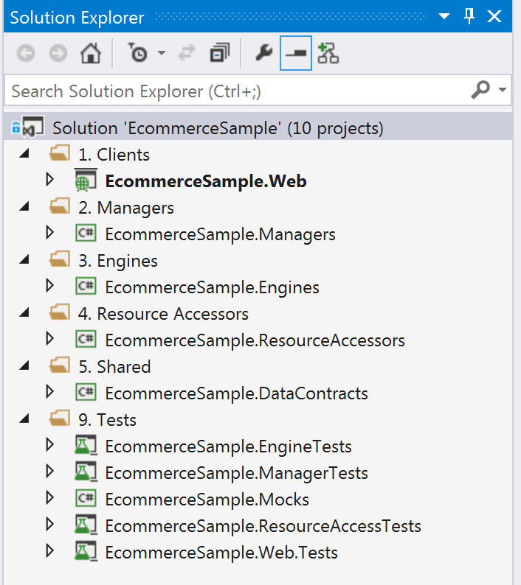
Translating the design to the solution…

